Slide 1
Security Analysis Tools
Information Security

Slide 2
Security Analysis Tools
Security Analysis Tools
Footprinting and Fingerprinting
Types of Analysis Tools

Slide 3
Security Analysis Tools
Security Analysis Tools
The ability to look at systems from the attacker’s point of view
Find vulnerabilities
Help prevent future attacks on systems
Create a better way to protect systems from attacks

Slide 4
Security Analysis Tools
Footprinting and Fingerprinting
Footprinting: determining what hostnames, IP addresses a target org.’s
Fingerprinting: systematic survey of resources found in footprinting stage
  Useful for discovering weaknesses in org.’s network or systems

Slide 5
Security Analysis Tools
Types of Analysis Tools
Port Scanners
Packet Analyzers
Content Filters
Trap and Trace Tools

Slide 6
Security Analysis Tools
Types of Analysis Tools: Port and Vulnerability Scanners
Are tools that automatically search networks for hosts and vulnerabilities
Software that is capable of finding all of the active computers, open ports, and services on a network
Are capable of scanning networks for very detailed information
Example
  Nmap:
  Nessus:

Slide 7
Security Analysis Tools
Types of Analysis Tools: Port and Vulnerability Scanners
Nmap
  An excellent security tool because it allows you to determine which services are being offered by a system.
Nessus
  A tool to scan systems and evaluate vulnerabilities present in services offered by that system.
  Best free network vulnerability scanner and the best to run on Linux

Slide 8
Security Analysis Tools
Types of Analysis Tools: Port and Vulnerability Scanners
Ports
  Ports act as logical communications endpoint for specific program on computers for delivery of data sent
  There are a total of 65,536 ports, numbering between 0 and 65,535
  Ports are defined by the Internet Assigned Numbers Authority or IANA
Notes:
A network socket is an internal endpoint for sending or receiving data within a node on a computer network.
-A socket consists of three things:
An IP address
A transport protocol
A port number
For example:
1030 is a port.
(10.1.1.2 , TCP , port 1030) is a socket.
A network socket is an internal endpoint for sending or receiving data within a node on a computer network.
-A socket consists of three things:
An IP address
A transport protocol
A port number
For example:
1030 is a port.
(10.1.1.2 , TCP , port 1030) is a socket.

Slide 9
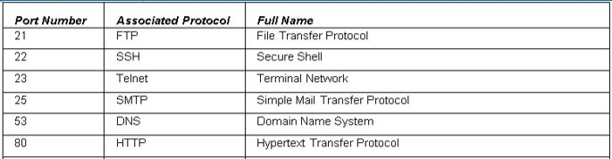
Security Analysis Tools
Types of Analysis Tools: Port and Vulnerability Scanners
Ports
Notes:
A network socket is an internal endpoint for sending or receiving data within a node on a computer network.
-A socket consists of three things:
An IP address
A transport protocol
A port number
For example:
1030 is a port.
(10.1.1.2 , TCP , port 1030) is a socket.
A network socket is an internal endpoint for sending or receiving data within a node on a computer network.
-A socket consists of three things:
An IP address
A transport protocol
A port number
For example:
1030 is a port.
(10.1.1.2 , TCP , port 1030) is a socket.

Slide 10
Security Analysis Tools
Types of Analysis Tools: Port and Vulnerability Scanners
TCP Connection, Establishment and Termination
  Establishes that the destination device is present on the network
  Verifies that the destination device has an active service and is accepting requests on the destination port number
  Informs the destination device that the source client plans to establish a communication session on that port number
Notes:
A network socket is an internal endpoint for sending or receiving data within a node on a computer network.
-A socket consists of three things:
An IP address
A transport protocol
A port number
For example:
1030 is a port.
(10.1.1.2 , TCP , port 1030) is a socket.
A network socket is an internal endpoint for sending or receiving data within a node on a computer network.
-A socket consists of three things:
An IP address
A transport protocol
A port number
For example:
1030 is a port.
(10.1.1.2 , TCP , port 1030) is a socket.

Slide 11
Security Analysis Tools
Types of Analysis Tools: Port and Vulnerability Scanners
TCP Connection, Establishment and Termination
Three-way handshake to establish connection
  Host A sends a SYN (open) to the host B
  Host B returns a SYN acknowledgment (SYN ACK)
  Host A sends an ACK to acknowledge the SYN ACK
A
B
SYN
SYN ACK
ACK
Data
Data
Notes:
A network socket is an internal endpoint for sending or receiving data within a node on a computer network.
-A socket consists of three things:
An IP address
A transport protocol
A port number
For example:
1030 is a port.
(10.1.1.2 , TCP , port 1030) is a socket.
A network socket is an internal endpoint for sending or receiving data within a node on a computer network.
-A socket consists of three things:
An IP address
A transport protocol
A port number
For example:
1030 is a port.
(10.1.1.2 , TCP , port 1030) is a socket.

Slide 12
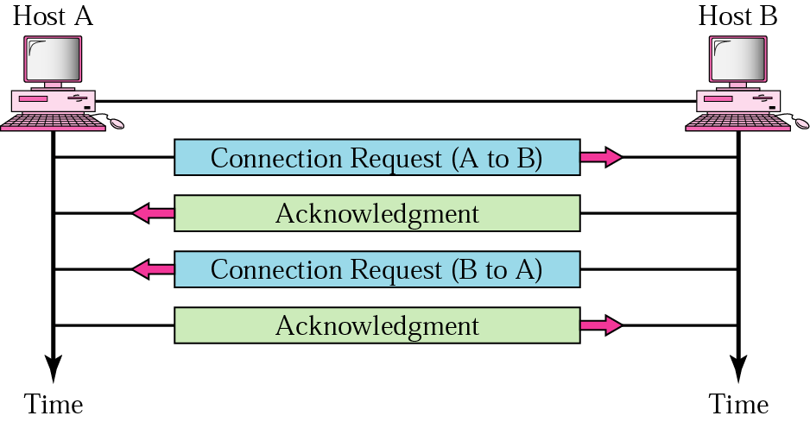
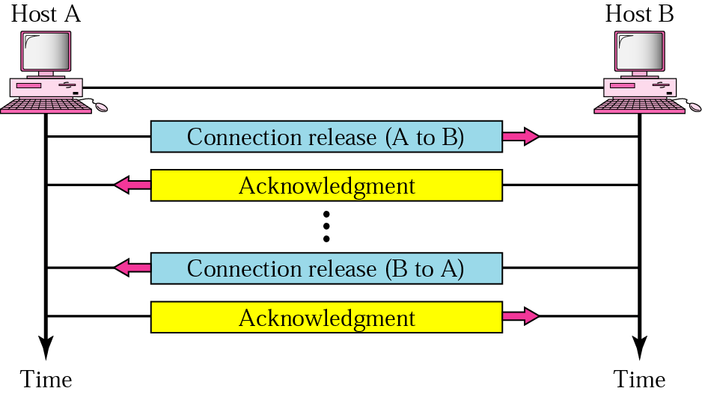
Security Analysis Tools
Connection
establishment
Combined into one step
Connection release
Notes:
A network socket is an internal endpoint for sending or receiving data within a node on a computer network.
-A socket consists of three things:
An IP address
A transport protocol
A port number
For example:
1030 is a port.
(10.1.1.2 , TCP , port 1030) is a socket.
A network socket is an internal endpoint for sending or receiving data within a node on a computer network.
-A socket consists of three things:
An IP address
A transport protocol
A port number
For example:
1030 is a port.
(10.1.1.2 , TCP , port 1030) is a socket.

Slide 13
Security Analysis Tools
Types of Analysis Tools: Packet Analyzers
A network tool that collects and analyzes copies of packets from a network
Can provide network admin with information to solve networking issues (or attacker eavesdropping)
Needs to be on the network that you want to sniff
Example
  TCPDUMP
  Ethereal
  Wireshark

